Slide 1

Lowe’s Campus Hackathon

Slide 2
Team Name: Bugo ke Bug, Debug
Theme Name: Smart Store Replenishment System
Team Members: 1) Arnav Rupde 2) Raj Shah

Slide 3
Architecture:
1. We have Sqlite database that contains product details like Product name, Product Id and quantity available.
We have provided flask webpages that will display product summary from database. It has option to predict future demand and order any product.
SMS to be sent to manager incase of less stocks available and requesting to order.
A page consisting of statistics of stocks such top 5 less sold, less monitored stocks and graph with respect to the same.

Slide 4
Working:
We are forecasting the future product demands using LSTM model.
The dataset is much concentrated to cell phone items and its sales for last 4 years which considers data into consideration of goods sold in various months, be in weather specifications, or any other events..
Based on demands and prediction, we have enabled ordering of the deficits, automatic and Manager Enabled..
A perfect portal system for individuals and company owner/manager to handle several requests.
Tracking feature is enabled along with predicted delivery date of ordered quants.

Slide 5
Working:
When user click on Predict Demand button, then Machine Learning model starts training using sales dataset available. Once training is finished, it will display future Demand of particular product.
ML gets trained with each transactions for better accuracy demands.
When user/customer buys goods, it will automatically reflect the database of stocks and enable auto-ordering system.

Slide 6
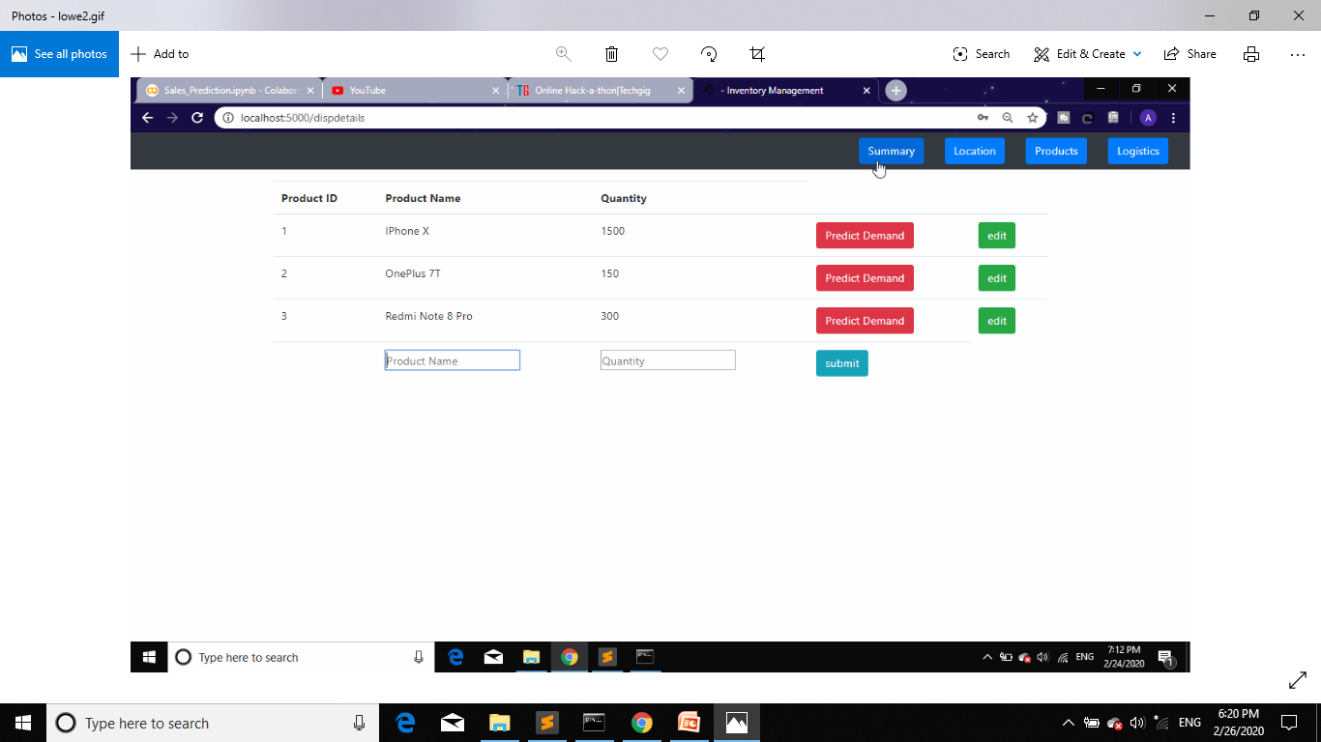
Inventory Summary

Slide 7
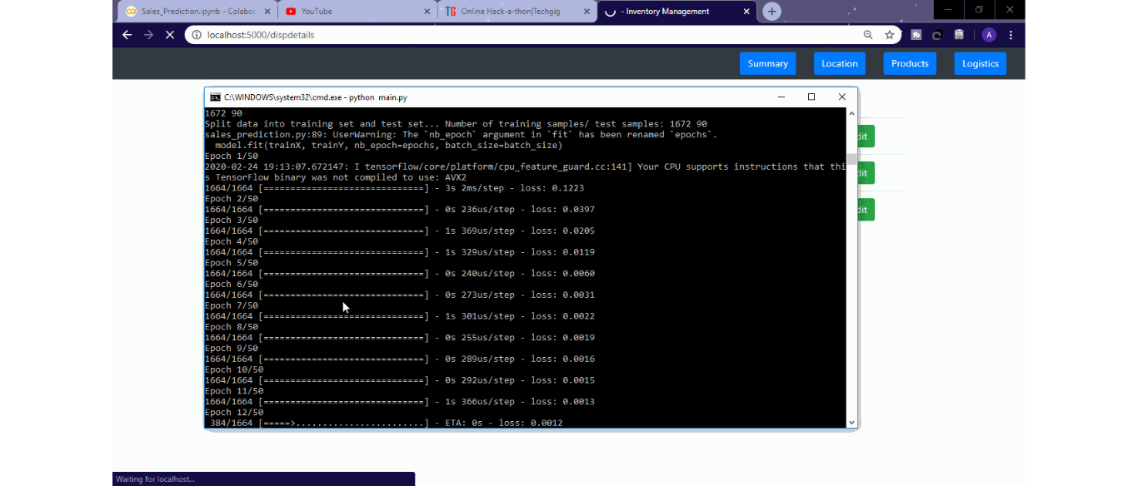
Training ML Model as Background Process

Slide 8
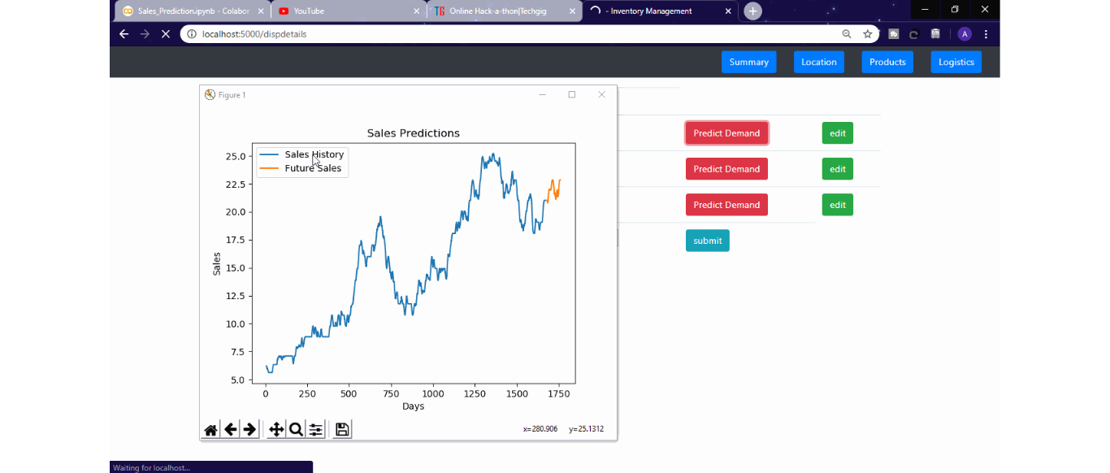
Sales Prediction Graph

Slide 9
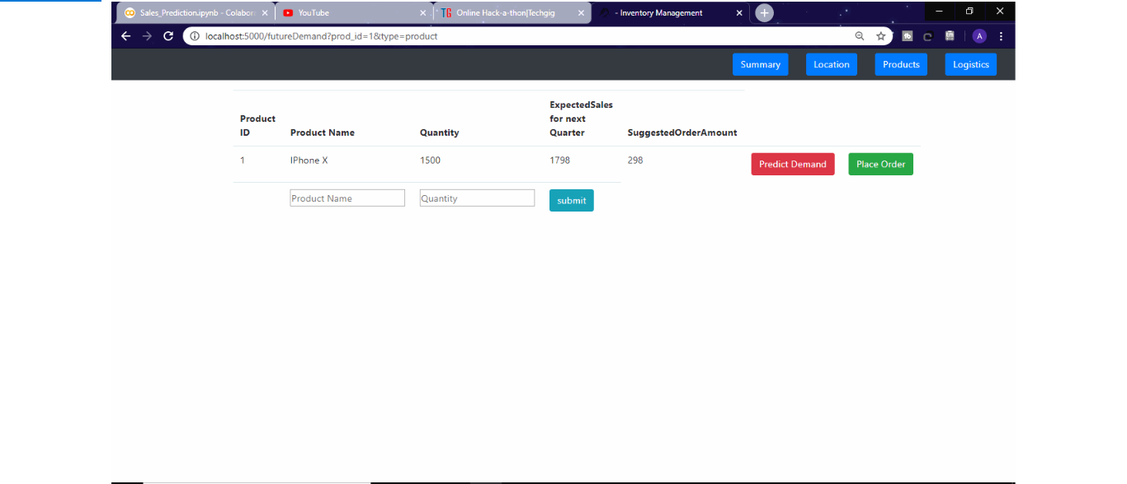
Demand Forecasting and Suggestion System

Slide 10
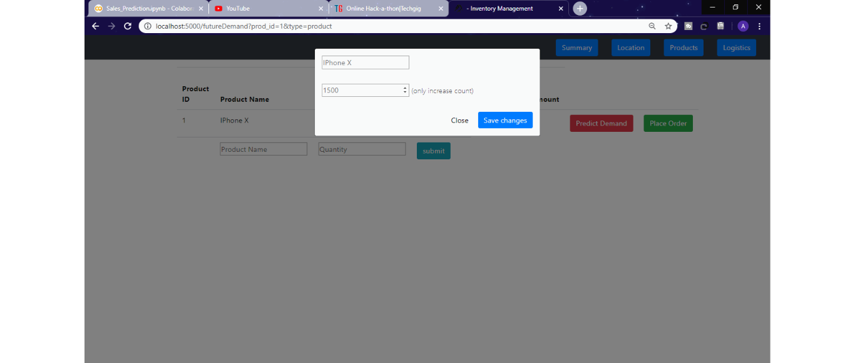
Order Product Amount

Slide 11
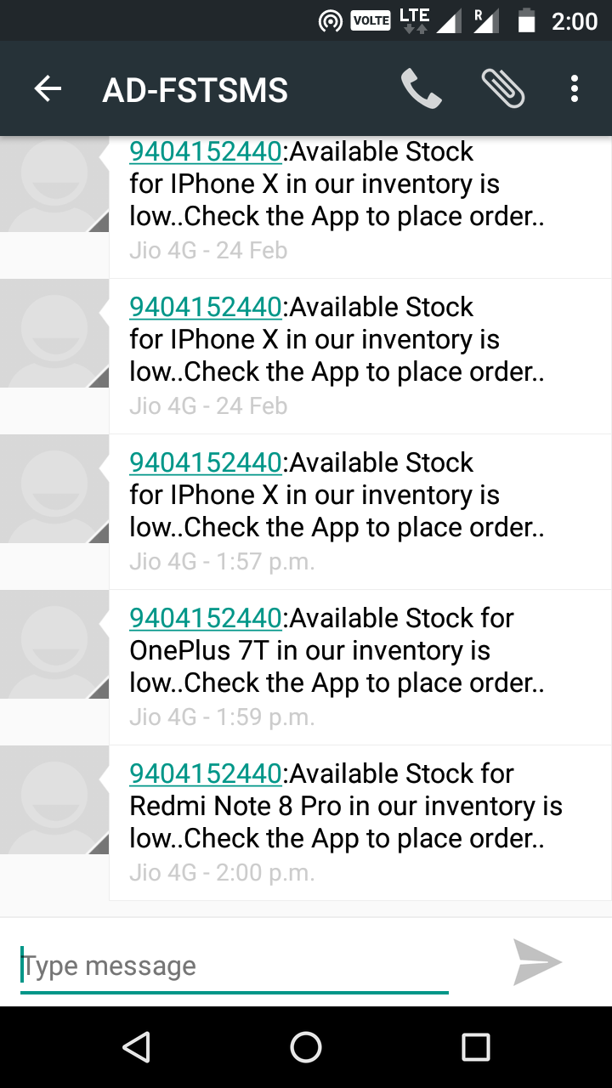
Instant SMS if Stock is low

Slide 12
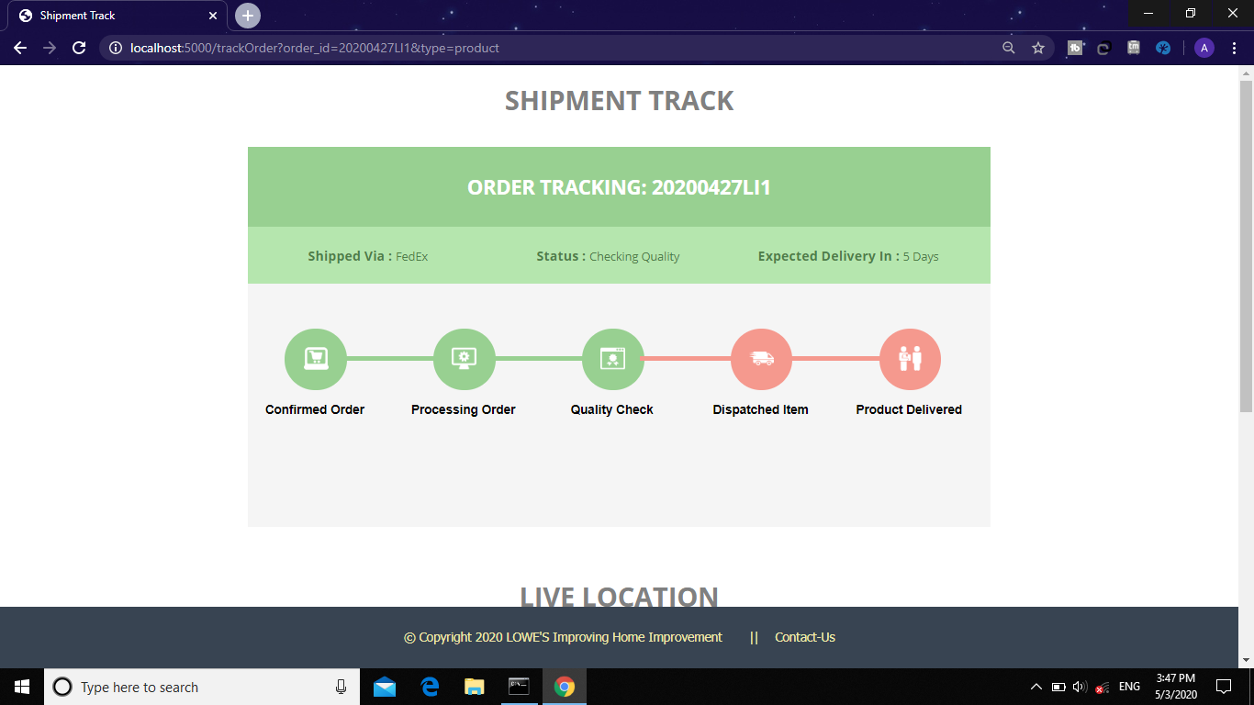
Order Tracking with Expected Date of Delivery

Slide 13
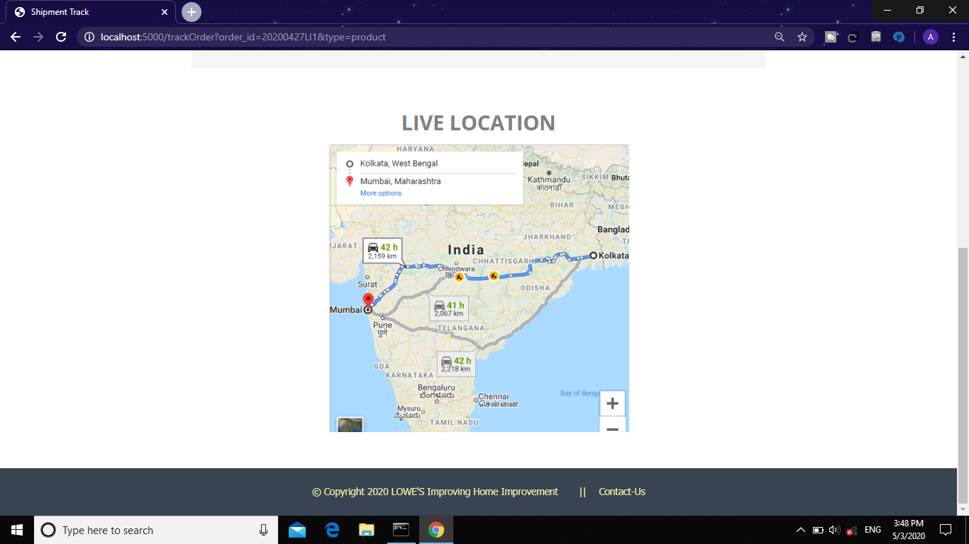
Best Possible Route of Delivery that determines expected date of Delivery.

Slide 14
Technology/Tool/Cloud Stack:
Python
Jupyter Notebook
Flask
Machine Learning(Libraries: SkLearn, Keras, Numpy, Pandas)
Databse: Sqlite3

Slide 15
Hardware Specifications:
This software can be run in any pc with at least 2GB RAM(needed for Machine Learning).
Project size is small(in few MBs). So it will run on most of the computers.

Slide 16
Demo - Video/Prototype (Youtube):
Video Demonstration available at:
https://youtu.be/-4A16D8Qplw

Slide 17
Source code (zipped/ private GitHub repository):
Github Repository:
https://github.com/ArnavRupde/SSRS

Slide 18
Challenges Faced:
Integrating Machine Learning Code with Web Application was difficult task because it takes some time to train the model.
Sales Dataset for training was not easily available. Thus, we created some dummy dataset for this purpose.

